Slide 1
6 Deadlock & Case Study
Deadlock system model
Characterization
Deadlock prevention
Deadlock avoidance
Bankers algorithm for simple and multiple resources
Deadlock detection and recovery

Slide 2
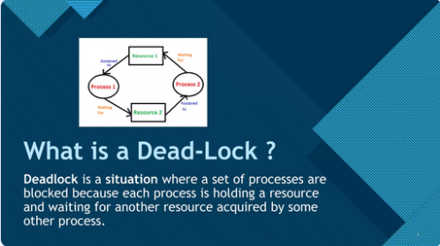

Slide 3
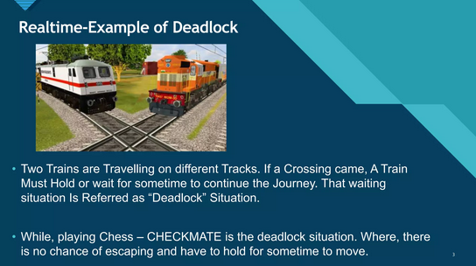

Slide 4
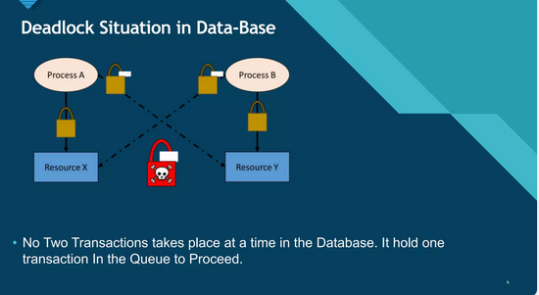

Slide 5
Deadlock System Model
Processes compete for shared resources.
Resources: Preemptible (e.g., CPU) & Non-preemptible (e.g., printer).
Resource Allocation Graph (RAG):
- Request edge: Process → Resource
- Assignment edge: Resource → Process

Slide 6
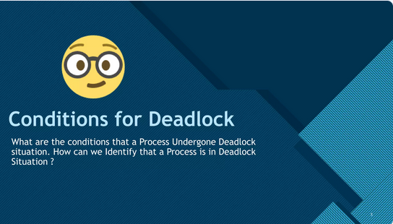

Slide 7
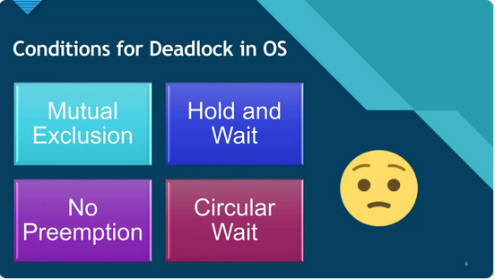

Slide 8
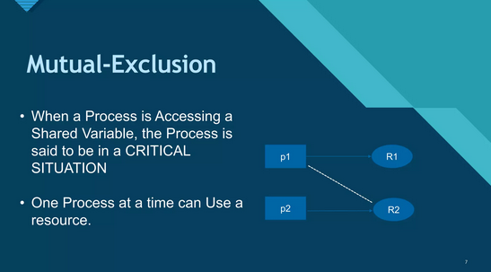

Slide 9
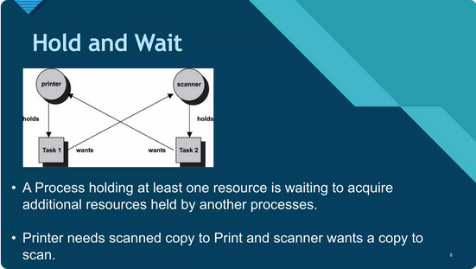

Slide 10
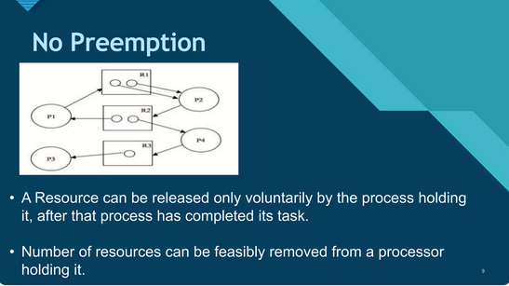

Slide 11
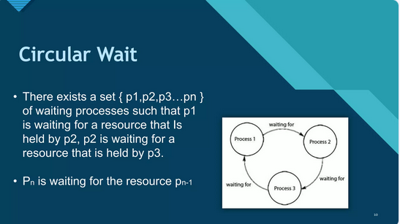

Slide 12
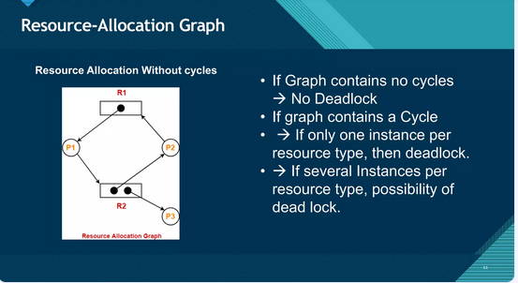

Slide 13
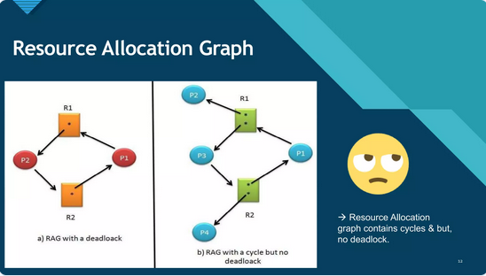

Slide 14
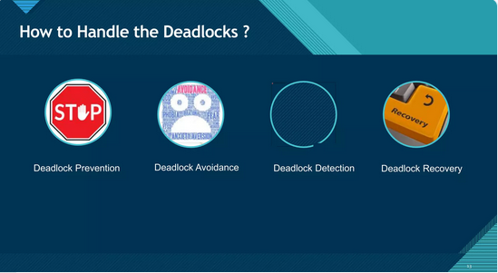

Slide 15
Method to handle Deadlock
Deadlock Avoidance (Ostrich Method)
Deadlock prevention
Deadlock Avoidance (Bankers Algo)
Deadlock detection and recovery

Slide 16
Deadlock Prevention
Ensure at least one of the four conditions doesn't hold:
1. Mutual Exclusion → Make resources shareable.
2. Hold and Wait → Request all at once.
3. No Preemption → Allow preemption.
4. Circular Wait → Impose resource ordering.

Slide 17
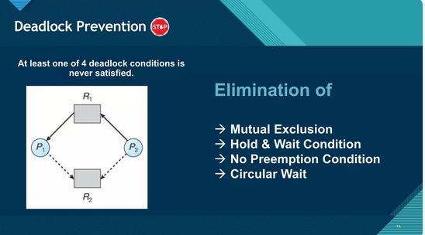

Slide 18
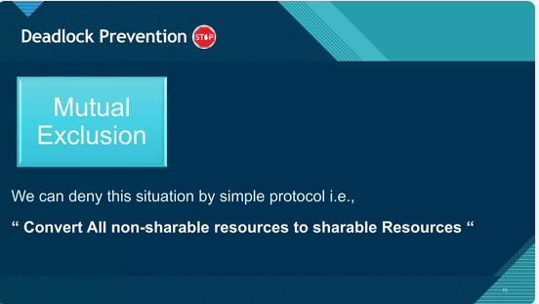

Slide 19
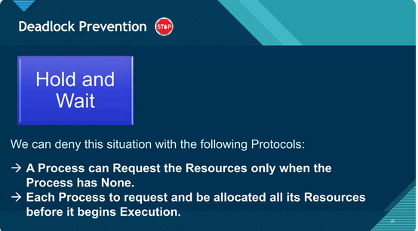

Slide 20
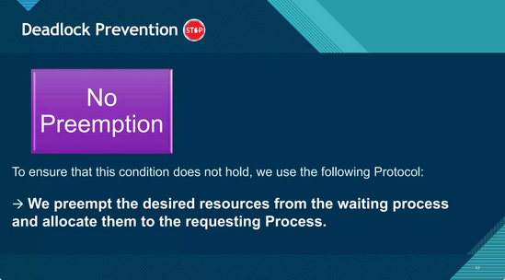

Slide 21
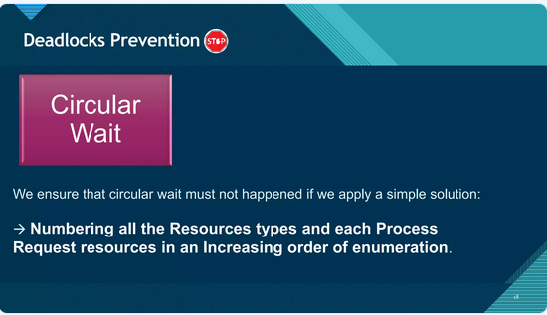

Slide 22
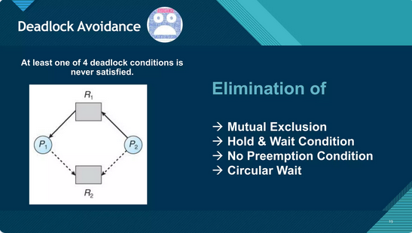

Slide 23
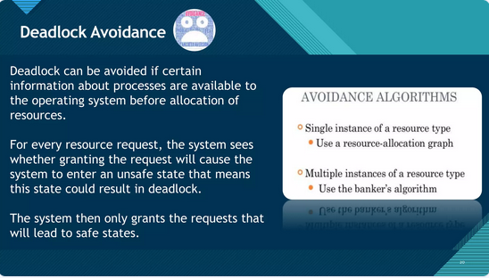

Slide 24
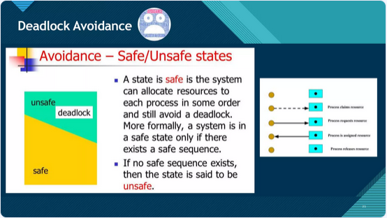

Slide 25
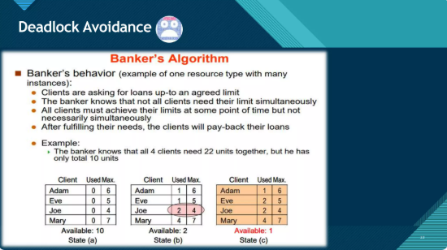

Slide 26
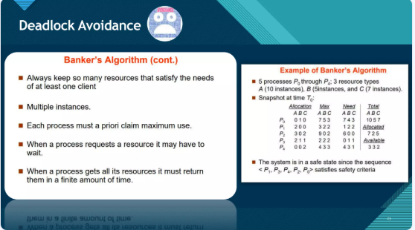

Slide 27
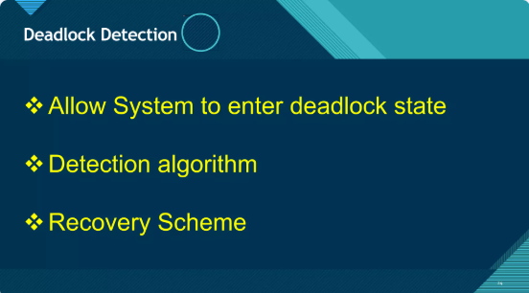

Slide 28
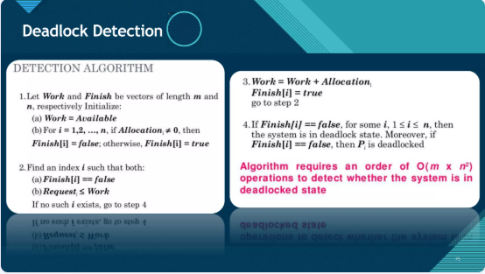

Slide 29
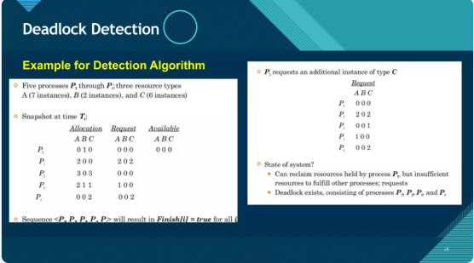

Slide 30
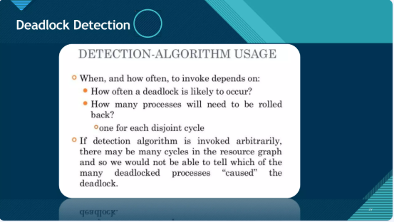

Slide 31
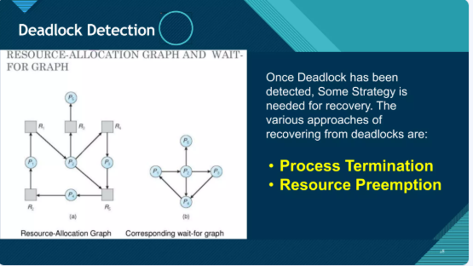

Slide 32
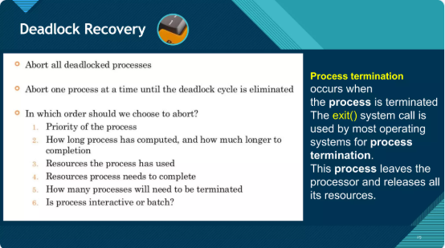

Slide 33
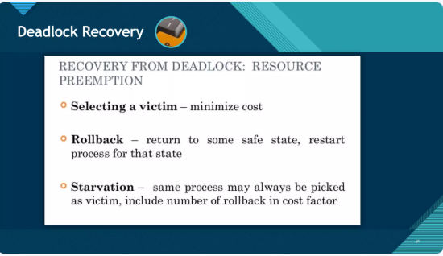

Slide 34
Deadlock Avoidance
Avoid unsafe states by careful allocation.
Requires knowledge of future requests.
Safe State: System can allocate resources in some order and avoid deadlock.

Slide 35
Banker's Algorithm - Single Resource
Based on Max, Allocation, Available, Need.
Steps:
1. Check if process's needs can be met.
2. Assume allocation and simulate completion.
3. Repeat for all processes.
4. If all finish → Safe State.

Slide 36
Banker's Algorithm - Multiple Resources
Use matrices/vectors: Available, Max[n][m], Allocation[n][m], Need[n][m].
Simulate safe sequence:
1. Work = Available; Finish[i] = false.
2. Find i: Finish[i] == false & Need[i] <= Work.
3. Work = Work + Allocation[i]; Finish[i] = true.
4. If all Finish[i] are true → Safe.

Slide 37
Deadlock Detection
Allow deadlock, detect it later.
Single Instance: Use Wait-for Graph (cycle = deadlock).
Multiple Instances:
- Track Allocation, Request, Available.
- Simulate to check if processes can finish.

Slide 38
Deadlock Recovery
Recovery strategies:
1. Process Termination:
- Abort all or one-by-one until cycle breaks.
2. Resource Preemption:
- Preempt resources, rollback processes.
- Consider cost and starvation risk.

